Slide 1
Object-Oriented Analysis and Design using JAVA
B.Tech (CSE/IT) 5th SEM
2021-2022
Lecture-12 Requirement elicitation and use cases

Slide 2
Introduction
There are many activities are performed during requirements elicitation. These activities map a problem statement into a requirements specification which is represented as a set of actors, scenarios, and use cases. Requirements elicitation activities include:
Identifying Actors
Identifying Scenarios
Identifying Use Cases
Refining Use Cases
Identifying Relationships Among Actors and Use Cases
Identifying Initial Analysis Objects
Identifying Non functional Requirements

Slide 3
Identifying actors
Actors represent external entities that interact with the system. An actor can be human or an external system or actor is a person or system that derives benefit from and is external to the subject.
Is depicted as either a stick figure (default) or, if a nonhuman actor is involved, a rectangle with <<actor>> in it (alternative).
Is labeled with its role.
Can be associated with other actors using a specialization/superclass association, denoted by an arrow with a hollow arrowhead.
Is placed outside the subject boundary.

Slide 4
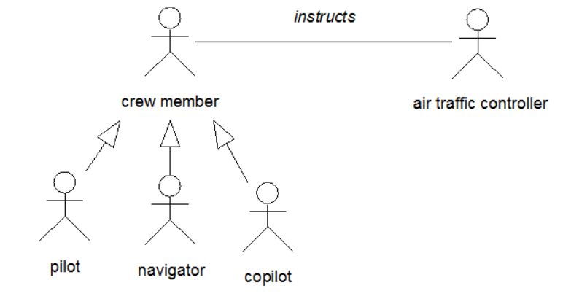
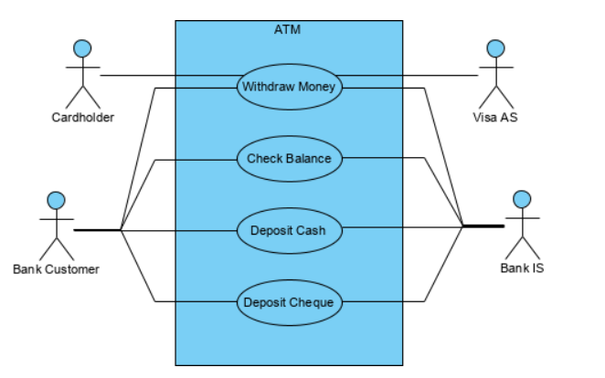
Questions for identifying actors
Which user groups are supported by the system to perform their work?
Which user groups execute the system’s main functions?
Which user groups perform secondary functions, such as maintenance and administration?
With what external hardware or software system will the system interact?
The primary actor of a use case is the stakeholder that calls on the system to deliver one of its services.
A supporting actor (also known as a secondary actor) in a use case in an external actor that provides a service to the system under design
In the example below, the Visa Card Holder and Bank Customer are Primary Actors, while the Visa AS and Bank IS are secondary actors.

Slide 5
Identifying Scenarios
A scenario is “a narrative description of what people do and experience as they try to make use of computer systems and applications”.
A scenario is a concrete, focused, informal description of a single feature of the system from the viewpoint of a single actor.
Scenarios cannot (and are not intended to) replace use cases, as they focus on specific instances and concrete events (as opposed to complete and general descriptions).
However, scenarios enhance requirements elicitation by providing a tool that is understandable to users and clients.

Slide 6
Scenarios can have many different uses during requirements elicitation and during other activities of the life cycle. Below is a selected number of scenario types taken from:
As-is scenarios describe a current situation. During reengineering, for example, the current system is understood by observing users and describing their actions as scenarios. These scenarios can then be validated for correctness and accuracy with the users.
Visionary scenarios describe a future system. Visionary scenarios are used both as a point in the modeling space by developers as they refine their ideas of the future system and as a communication medium to elicit requirements from users. Visionary scenarios can be viewed as an inexpensive prototype.
Evaluation scenarios describe user tasks against which the system is to be evaluated. The collaborative development of evaluation scenarios by users and developers also improves the definition of the functionality tested by these scenarios.
Training scenarios are tutorials used for introducing new users to the system. These are step-by-step instructions designed to hand-hold the user through common tasks.
Bernd Bruegge & Allen H. Dutoit - Object-Oriented Software Engineering: Using UML, Patterns, and Java

Slide 7
Questions for identifying scenarios
What are the tasks that the actor wants the system to perform?
What information does the actor access? Who creates that data? Can it be modified or removed? By whom?
Which external changes does the actor need to inform the system about? How often? When?
Which events does the system need to inform the actor about? With what latency?
Bernd Bruegge & Allen H. Dutoit - Object-Oriented Software Engineering: Using UML, Patterns, and Java

Slide 8
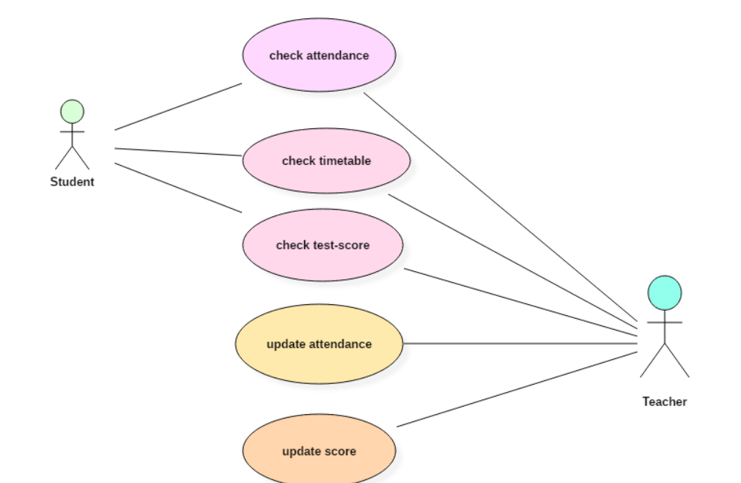
Identifying Use Cases
A scenario is an instance of a use case; that is, a use case specifies all possible scenarios for a given piece of functionality. A use case is initiated by an actor. After its initiation, a use case may interact with other actors, as well. A use case represents a complete flow of events through the system in the sense that it describes a series of related interactions that result from its initiation.
Use cases are used to represent high-level functionalities and how the user will handle the system. A use case represents a distinct functionality of a system, a component, a package, or a class. It is denoted by an oval shape with the name of a use case written inside the oval shape.
Bernd Bruegge & Allen H. Dutoit - Object-Oriented Software Engineering: Using UML, Patterns, and Java

Slide 9
Simple Use Case Writing Guide
Use cases should be named with verb phrases. The name of the use case should indicate what the user is trying to accomplish
Actors should be named with noun phrases
The boundary of the system should be clear. Steps accomplished by the actor and steps accomplished by the system should be distinguished
Use case steps in the flow of events should be phrased in the active voice. This makes it explicit who accomplished the step.
The causal relationship between successive steps should be clear.
A use case should describe a complete user transaction.
Exceptions should be described separately.
A use case should not describe the user interface of the system. This takes away the focus from the actual steps accomplished by the user and is better addressed with visual mock-ups
A use case should not exceed two or three pages in length. Otherwise, use include and extend relationships to decompose it in smaller use cases,

Slide 10
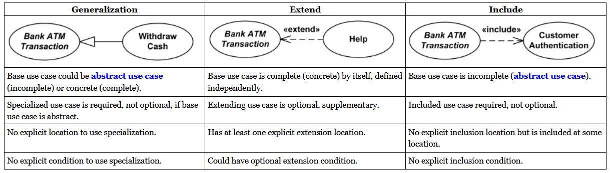
Identifying Relationships among Actors and Use Cases
Communication relationships between actors and use cases
Extend relationships between use cases
Include relationships between use cases
Extend versus include relationships

Slide 11
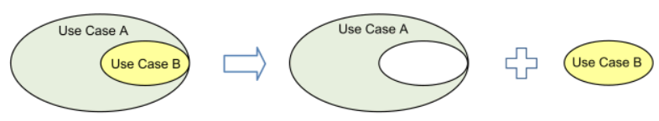
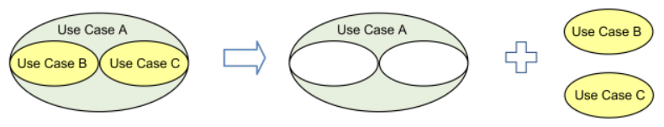
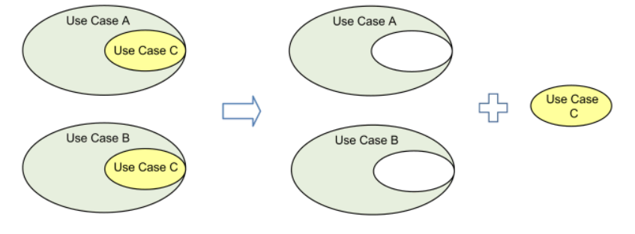
Use case include is a directed relationship between two use cases which is used to show that behavior of the included use case (the addition) is inserted into the behavior of the including (the base) use case.
The include relationship could be used:
to simplify large use case by splitting it into several use cases,
to extract common parts of the behaviors of two or more use cases.

Slide 12
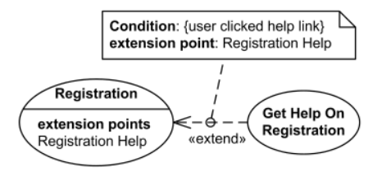

Extend is a directed relationship that specifies how and when the behavior defined in usually supplementary (optional) extending use case can be inserted into the behavior defined in the extended use case.
Extended use case is meaningful on its own, it is independent of the extending use case. Extending use case typically defines optional behavior that is not necessarily meaningful by itself. The extend relationship is owned by the extending use case. The same extending use case can extend more than one use case, and extending use case may itself be extended.
Registration use case is complete and meaningful on its own. It could be extended with optional Get Help On Registration use case.
Registration use case is conditionally extended by Get Help On Registration use case in extension point Registration Help.

Slide 13
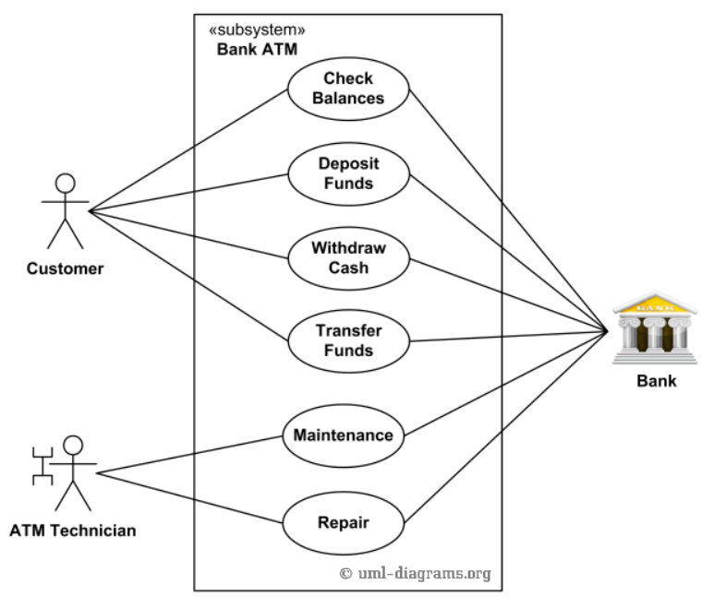
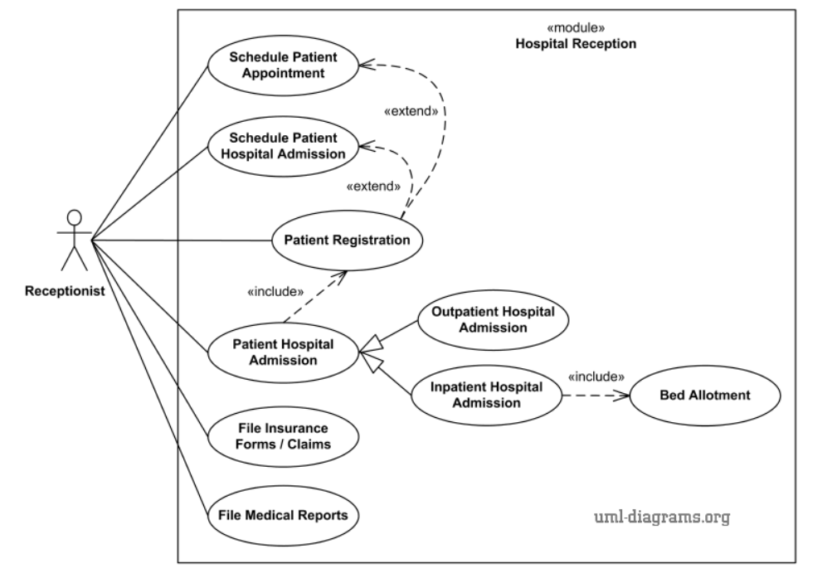
Examples of use-case diagrams

Slide 14
Summary
Use case diagrams are a way to capture the system's functionality and requirements in UML diagrams.
It captures the dynamic behavior of a live system.
A use case diagram consists of a use case and an actor.
A use case represents a distinct functionality of a system, a component, a package, or a class.
An actor is an entity that initiates the use case from outside the scope of a use case.
The name of an actor or a use case must be meaningful and relevant to the system.
A purpose of use case diagram is to capture the core functionalities of a system.

Slide 15
Key references
Bernd Bruegge & Allen H. Dutoit - Object-Oriented Software Engineering: Using UML, Patterns, and Java
https://www.guru99.com/use-case-diagrams-example.html
https://www.uml-diagrams.org/use-case-include.html

Slide 16
Thank You

